Slide 1


Slide 2


1. What is XSS
2. Types Of XSS
3. How to find XSS
4. Tools To find XSS
5. Live Demo

Slide 3

What is Cross Site Scripting
Cross-site scripting is a type of attack in which malicious scripts are injected into websites and web applications for the purpose of running on the client side or end user's device.
The XSS has a wide range of effects
It includes user session hijacking, malicious redirects can result in the revelation of sensitive data, CSRF attacks and other security flaws.

Slide 4
Types of Cross-site Scripting
Reflected XSS
Stored XSS
DOM-Based XSS
Blind XSS

Slide 5
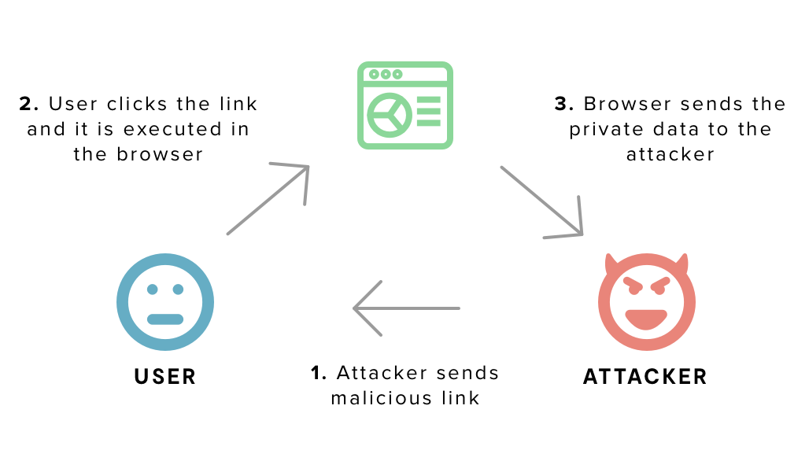
Reflected XSS
Reflected cross-site scripting (or XSS) occurs when an application receives data in an HTTP request and includes that data in an unsafe manner within the immediate response.

Slide 6
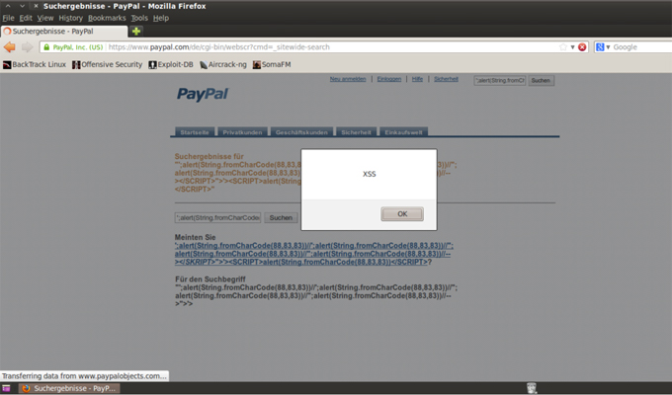
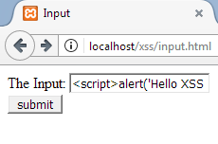
How to find Reflected XSS
Reflected XSS are found in the parameters or anything which can take your input. So that you can use that input point as an injection point.

Slide 7
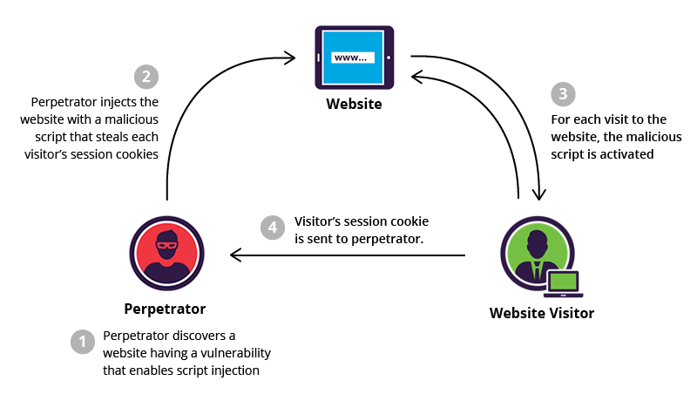
Stored XSS
Stored XSS is possible only when the application is designed to store user input. The attacker would inject the code through requests to the application

Slide 8
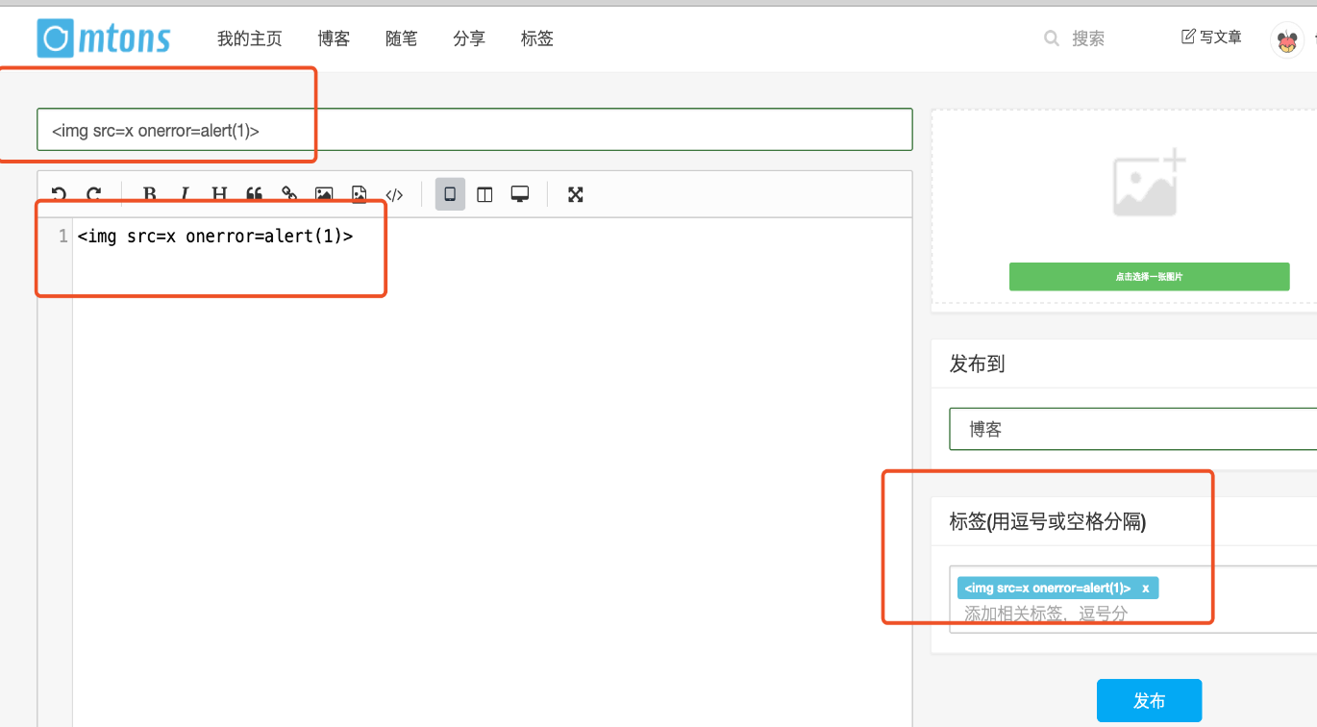
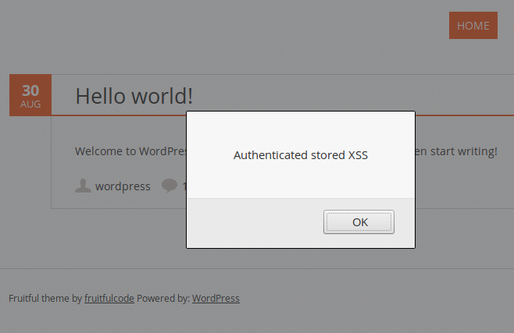
How to find stored XSS
The first thing you must realise is that we require an input point that will store our data in the database.

Slide 9
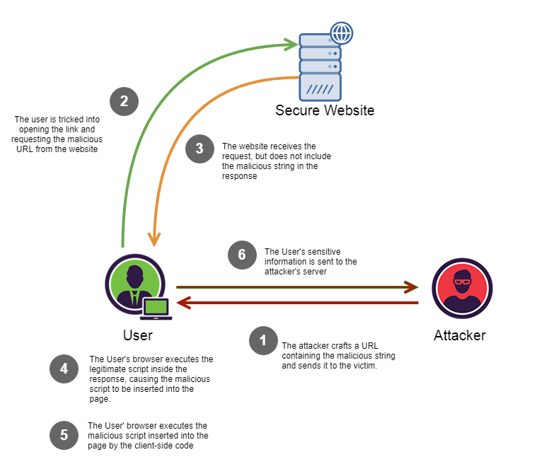
DOM-Based XSS
DOM-based XSS vulnerabilities are a type of Cross-site Scripting (XSS) vulnerabilities. A DOM-based XSS attack is possible if the web application writes data to the Document Object Model (DOM) without proper sanitization. The attacker can manipulate this data to include, malicious JavaScript code.

Slide 10
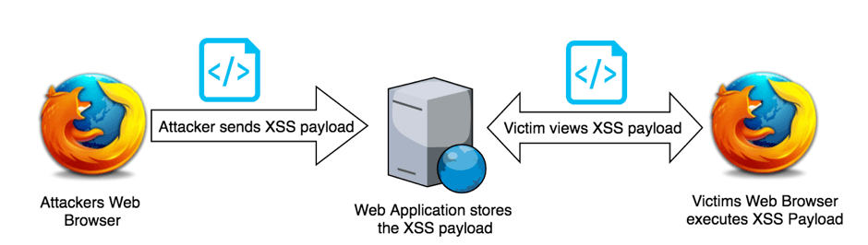
Blind XSS
Blind XSS vulnerabilities are is same as Stored XSS. They occur when the attacker input is saved by the web server and executed as a malicious script in another part of the application or in another application.

Slide 11
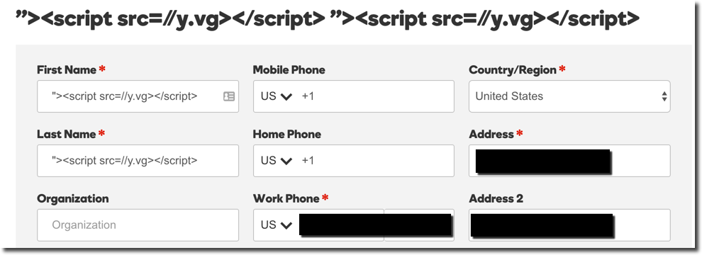
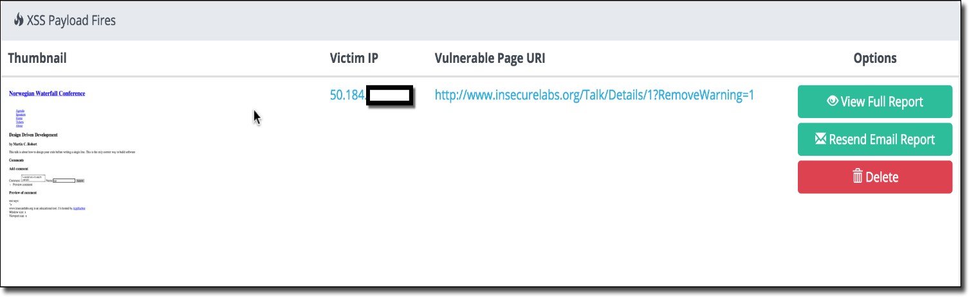
How to find blind XSS
This XSS is similar to Stored XSS, but you won't get popups right away.
This is dependent on when the administrator or developer visits that page on the server-side, and you will receive an email alert.

Slide 12
Automation Tools To find XSS
Param spider:- https://github.com/devanshbatham/ParamSpider
python3 paramspider.py –domain example.com -o xssParams.txt
GAUPLUS:- https://github.com/bp0lr/gauplus
cat target.txt | gauplus -o urls3.txt
Google dorks:- https://www.boxpiper.com/posts/google-dork-list

Slide 13
Arjun params:- https://github.com/s0md3v/Arjun
arjun -i TargetURLs.txt -t 100 --passive -oT arjun_params.txt
GF tool:- https://github.com/tomnomnom/gf
cat paramlist.txt | gf xss > xss.txt
Nuclei :- https://github.com/projectdiscovery/nuclei
nuclei -u http://example.com/param?id=1 -tags xss
Dalfox :- https://github.com/hahwul/dalfox
dalfox url [url]

Slide 14
THANK YOU

